Slide 1

Week six progress report
GROUP MEMBERS
Eunice Orenge
LABAN Mwangi
Stephen Kinuthia
Victor Ngatia

Slide 2
Objectives of the week
Visit KIRI EV Limited
Visit ROAM(OPIBUS LTD)
Buck convertor PCB design

Slide 3
KIRI EV LIMITED

Slide 4
ROAM(OPIBUS LTD)

Slide 5
SUGGESTIONS
The acceleration error could be as a result of a faulty pedal
Some of the components in the controller could be damaged and hence the unexpected output voltages in some of the pins.
The Encoder or the hall sensors could be damaged and as a result cause the encoder error

Slide 6
RECOMMENDATION
Identify the damaged components and try to replace them.
Replacing the controller since it may be damaged
When setting up the controller for testing, we should first confirm the set parameters using the controller’s software
In the event of replacing the motor controller, we should ensure its replacement is compatible with the existing kit
Careful selection of buck convertors

Slide 7
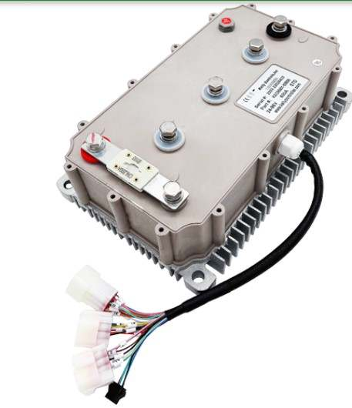
Controller selection
1. KELLY CONTROLLER
Type: KAC 96601 8080N
Input voltage:96 volts (24-96) with a maximum voltage of up to 115v
Current: 600A
Price :$699
Compatible pedal: $59
CAN Cable: ?
Display : N/A
Supplier: Qingdao Greatway Technology Co., Ltd.(Alibaba)
2. Purchase a similar controller with all the necessary components

Slide 8
PCB design
SCHEMATIC DIAGRAM

Slide 9
2. 3D PCB Design

Slide 10

Thank You!

